Slide 1
Amazon EC2 Systems Manager
Julien Lépine, Principal Solutions Architect

Slide 2
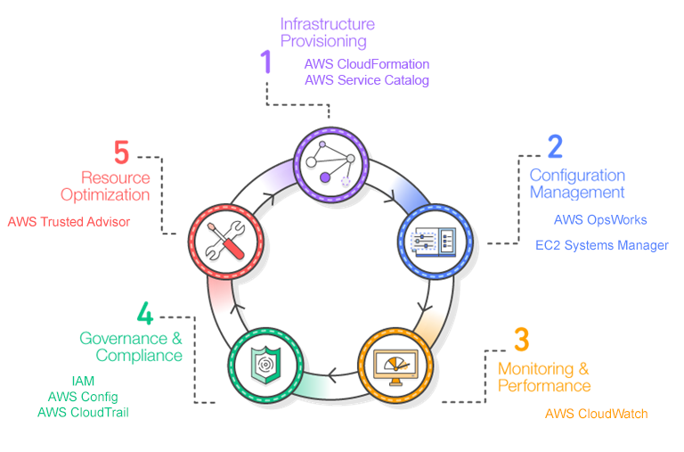
AWS Management Services

Slide 3



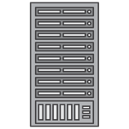
Key drivers
Secure
Scalable
Hybrid

Slide 4




How do I…
Distributed
Hands-free
Programmatic

Slide 5
How do I…
Execute a command on multiple instances?

Slide 6
How it works
Select a document from the bank of available documents, author new ones, share them
Select managed instances from your Amazon EC2 instances or on-premises instances by tag or id
Set the parameters for command customization
Save the output to Amazon S3 for traceability
1
2
3
4

Slide 7
Wait, what’s a document?
{
"schemaVersion": "2.0",
"description": "Installs a Windows Feature",
"parameters": {
"feature": {
"type”: "String",
"description": "Specify a package to install"
}
},
"mainSteps": [ {
"action": "aws:runPowerShellScript",
"name": "run",
"inputs": { "commands": "Install-WindowsFeature {{feature}}" }
} ]
}

Slide 8
And what’s a managed instance?

Slide 9
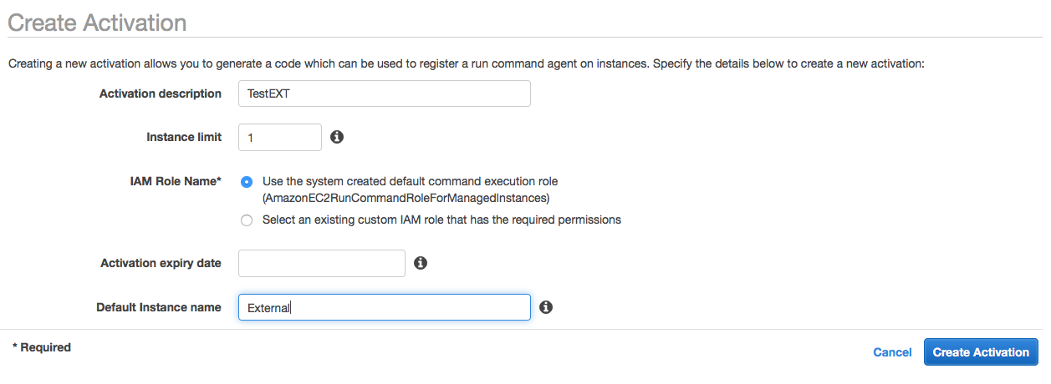
Activate hybrid instances

Slide 10
Activate hybrid instances

Slide 11


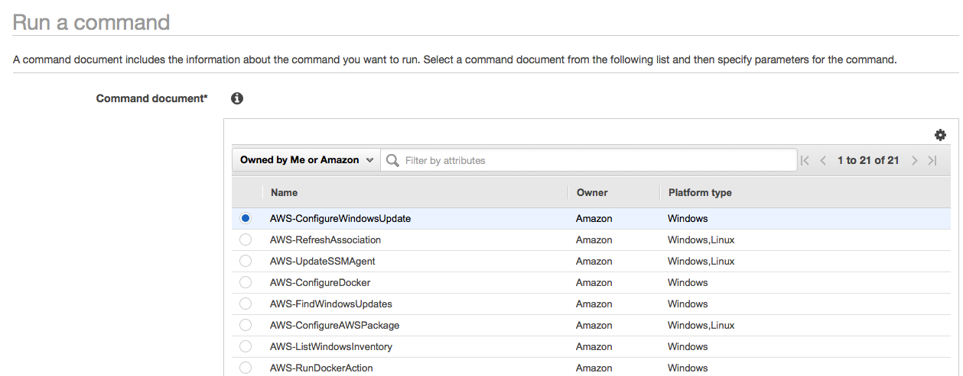
Ok now I can run it, select a document

Slide 12
Select an instance

Slide 13
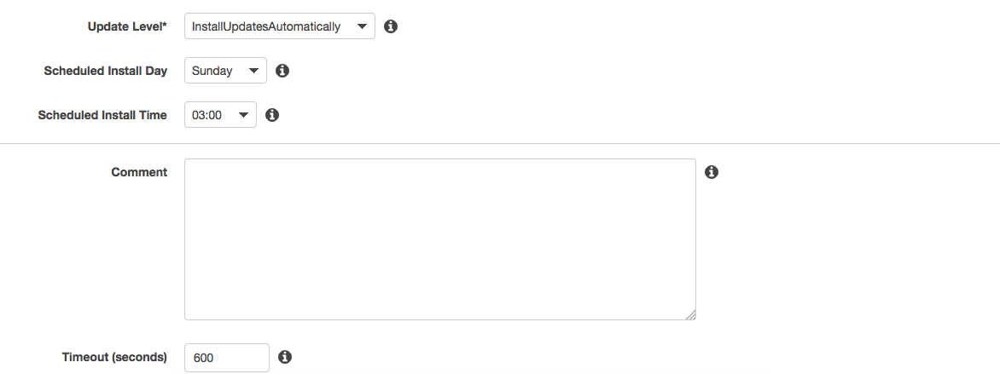
Set the parameters

Slide 14
Validate or get the equivalent CLI

Slide 15
View and manage your commands

Slide 17
How do I…
Bootstrap my instance AND maintain my state?

Slide 18
How it works
Select a document from the bank of available documents, author new ones, share them (again)
Select managed instances from your Amazon EC2 or on-premises instances by tag or id (still)
Set the parameters for command customization
Set a schedule for your state review
1
2
3
4

Slide 19
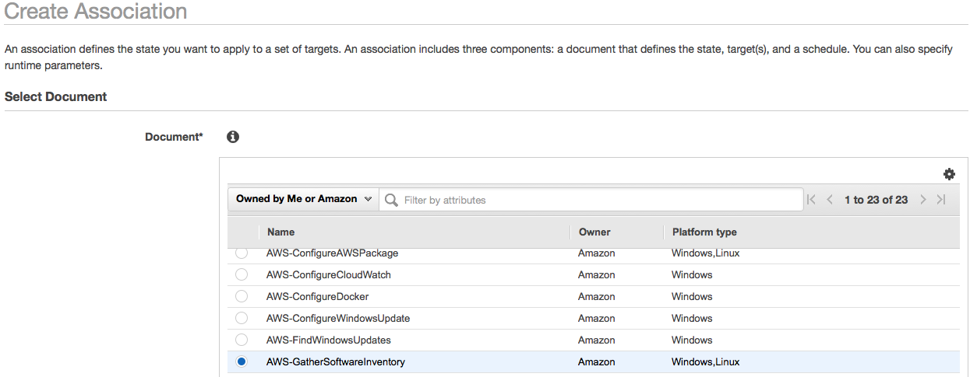
Select a document

Slide 20
Select instances

Slide 21
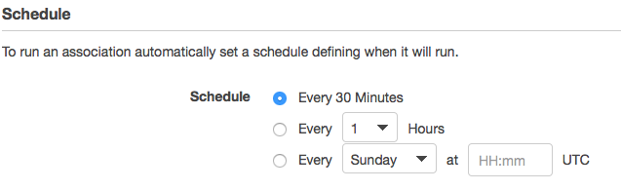
Define a schedule

Slide 22
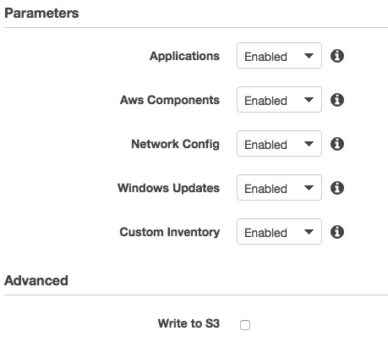
Set parameters

Slide 24
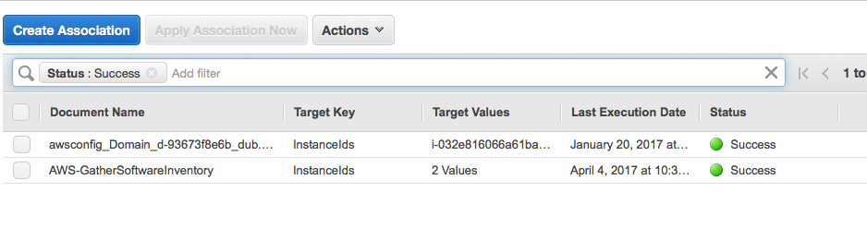
View and manage your associations

Slide 25
How do I…
Know what’s installed on my instances?

Slide 26
How it works
It’s a state! It works just the same way
1

Slide 27
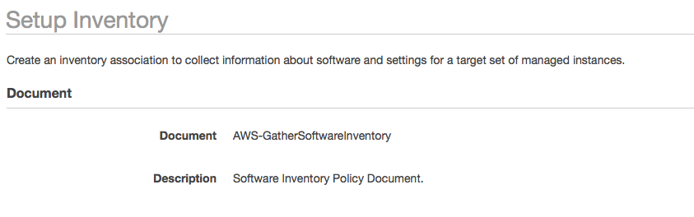
The document is selected

Slide 28
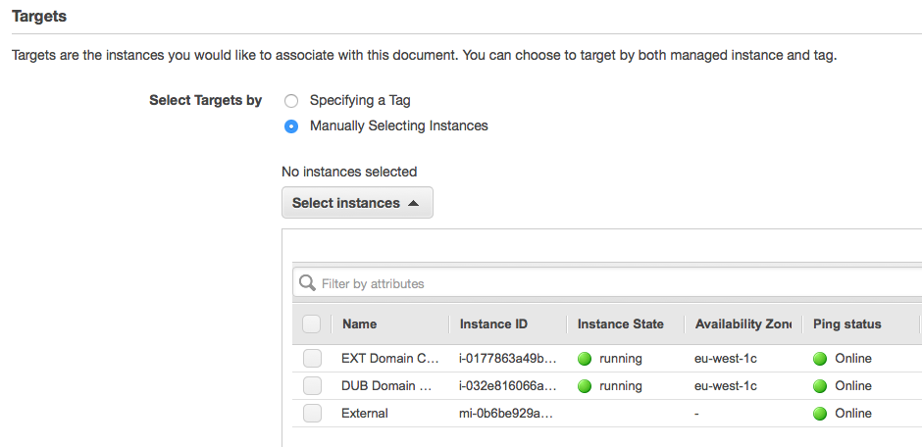
Select your instances

Slide 29
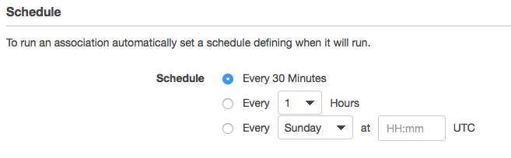
Select your Schedule

Slide 30
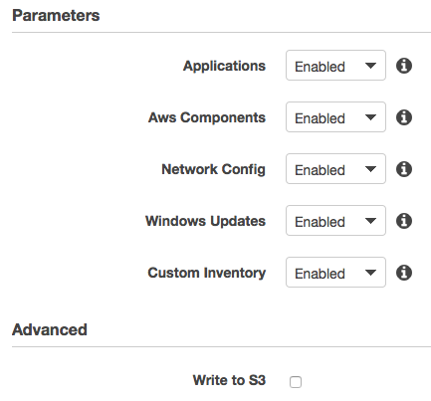
Select the parameters

Slide 32
You can put custom inventory
Aws ssm put-inventory
--instance-id "ID”
--items '[{"CaptureTime": "2016-08-22T10:01:01Z", "TypeName": "Custom:RackInfo", "Content":[{"RackLocation": "Bay B/Row C/Rack D/Shelf E"}], "SchemaVersion": "1.0"}]'

Slide 33
Ok, now what can I do with it?

Slide 34
You can request instances for their inventory
aws ssm get-inventory --filters Key=AWS:InstanceInformation.PlatformType,
Values=Windows,
Type=Equal
Key=AWS:InstanceInformation.ResourceType,
Values=ManagedInstance,
Type=Equal

Slide 35
Follow the configuration

Slide 37
How do I…
Apply changes on a schedule?

Slide 38
How it works
Create a window from a schedule (CRON compatible)
Select managed instances from your Amazon EC2 or on-premises instances by tag or id (still)
Select the tasks for command customization
1
2
3

Slide 39
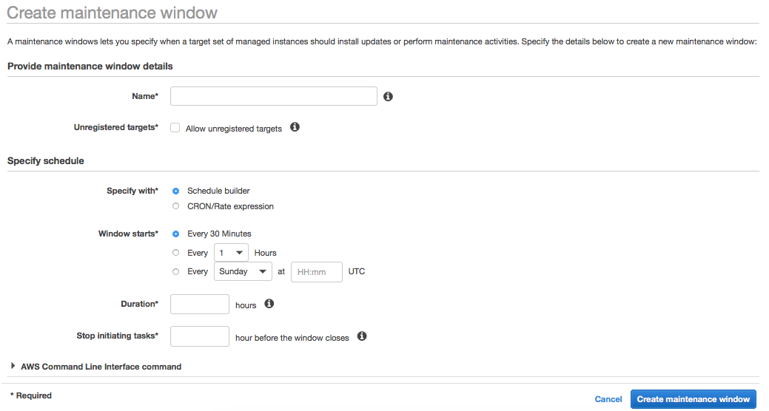

Slide 40
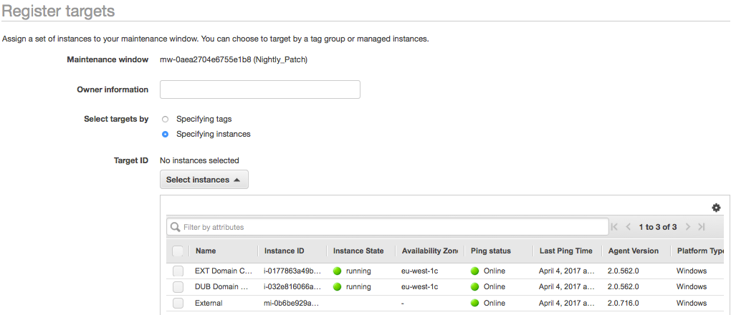
Register a target

Slide 41
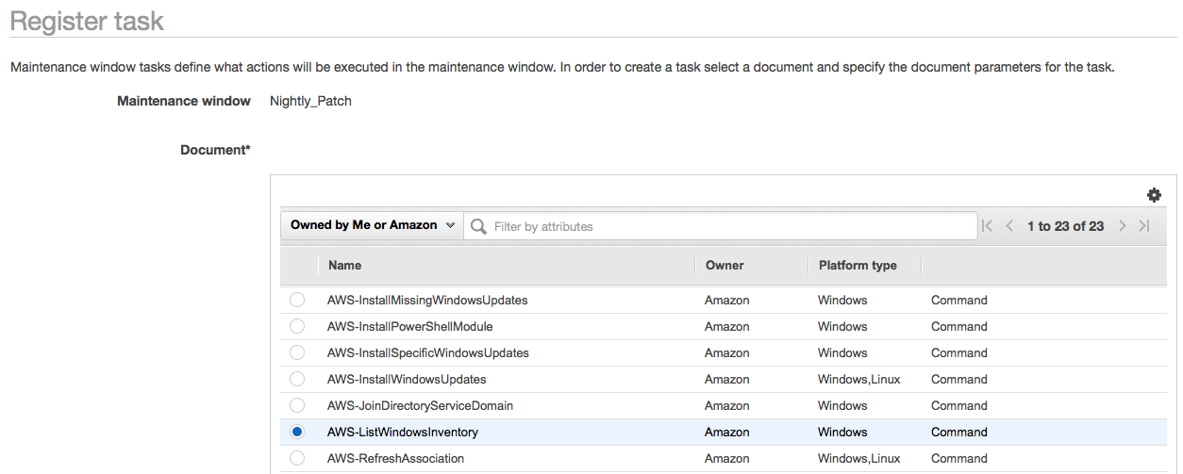
Register a task

Slide 42
Specify parameters and execution model

Slide 43
How do I…
Patch my Windows Amazon EC2 Instances?

Slide 44
How it works
Create a baseline for your patches
Select a patch group from your Amazon EC2 instances by tag
Create a Maintenance Window for applying your patches (by tag)
1
2
3

Slide 45
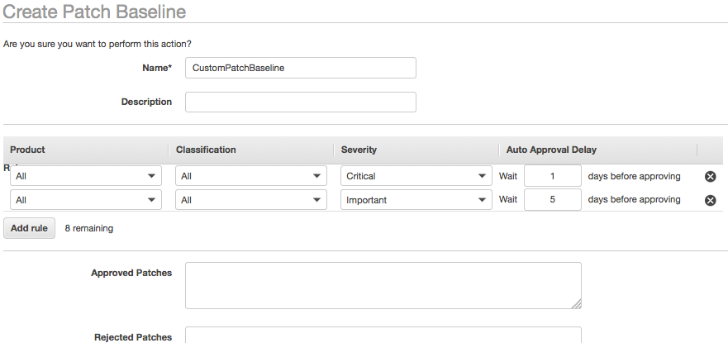
Create a baseline

Slide 46
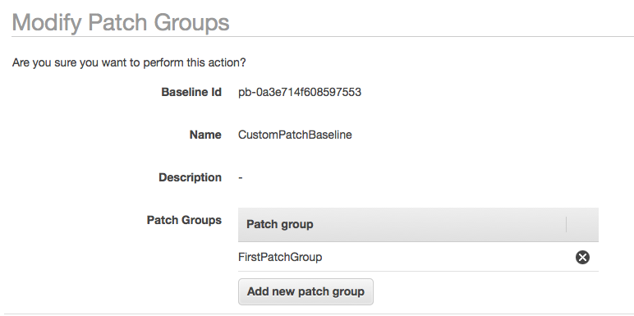
Attach the patch group to your policy (by tag)

Slide 47
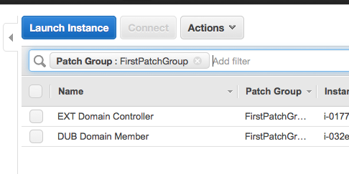
Tag Your Instances

Slide 48
How do I…
Automate my processes?

Slide 49
How it works
Run an automation document directly in the console or via API from a document
Leverage Maintenance Windows to have regular (or event-based) automation documents executed
1
2

Slide 50
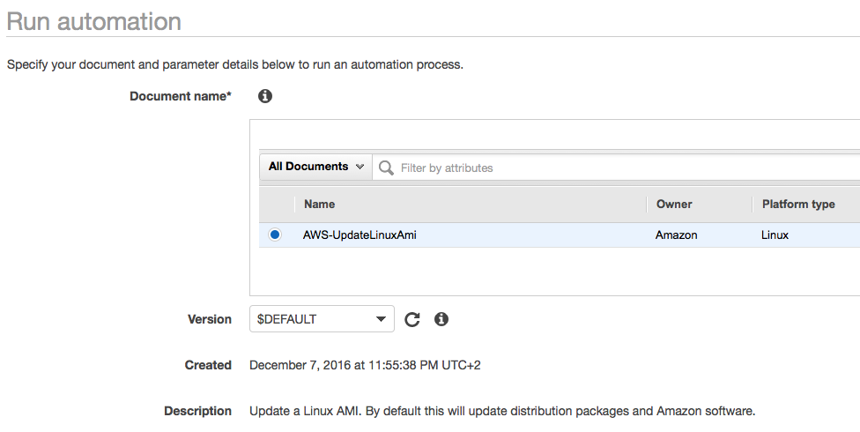
Select a document

Slide 51
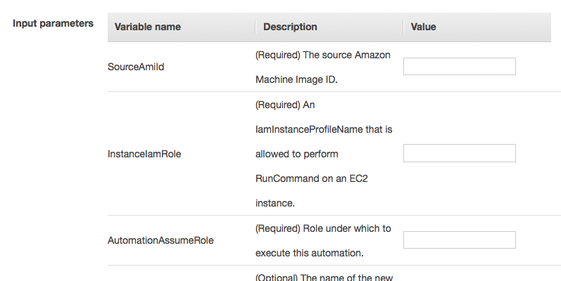
Specify the parameters

Slide 52




What can I do ?
Everything that a document allows ☺
Automate processes *inside* and *outside* the instances
Processes
Supports
Up-to-date AMIs
Build Processes
EC2
Lambda
AMI
Run Command

Slide 53
How do I…
Secure my secrets?

Slide 54
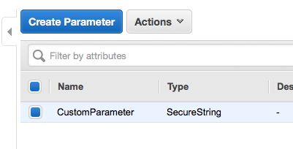

Slide 55



Integrated
AWS IAM
AWS KMS
Amazon CloudTrail

Slide 56
Using Parameter Store
Leverage in your EC2 Systems Manager Documents
Integrate in your code or command lines
AWS SDK and Lambda
AWS PowerShell CmdLets
AWS CLI

Slide 57
Customer challenges
Traditional IT toolset not built for cloud scale infrastructure
Maintaining enterprise-wide visibility is challenging
Deploying multiple products is a significant overhead
Licensing costs & complexity
Managing cloud and hybrid environments using a traditional toolset is complex and costly

Slide 58



Integrated services
AWS IAM
AWS CloudWatch
Events
AWS Config
Amazon S3
Amazon CloudTrail

Slide 59
Amazon EC2 Systems Manager – Components
Run Command
State Manager
Inventory
Maintenance Window
Patch Manager
Automation
Parameter Store

Slide 60
How to get started
Create an AWS Account
Oh, EC2 Systems Manager is free! Try it!
Contact us and come meet us
AWS and partners offer training and certification

Slide 61
Julien Lépine lepine@amazon.fr

